Slide 1
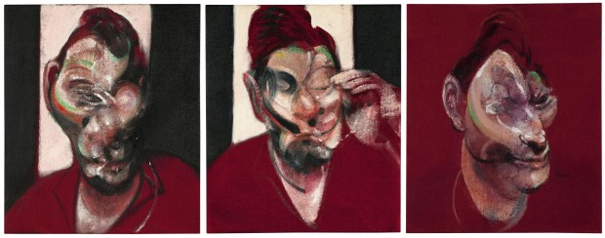
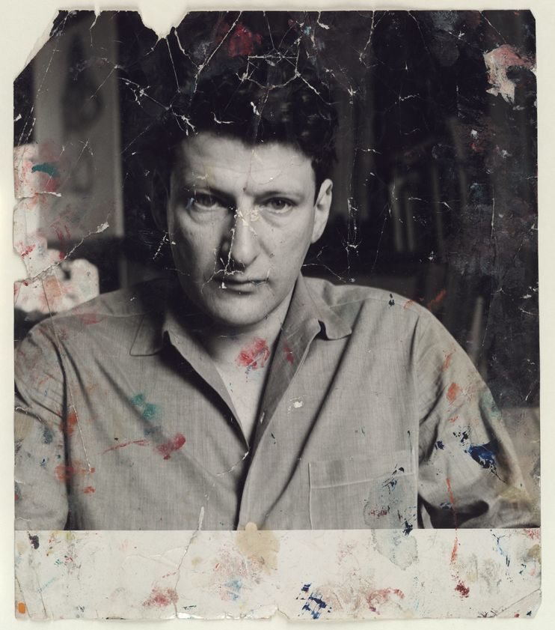
People can be flawed, false, unfriendly, cruel, kind, demanding, impetuous – all things at once.
Francis Bacon felt he could be honest in his portrayal of his friends and chose to paint all the emotion – negative and positive – (mostly negative), that he could see. A real portrayal of the sitter.
Francis Bacon, Three Studies for a Portrait of Lucian Freud, 1964
“If they were not my friends, I could not do such violence to them.” Francis Bacon, 1966
Task:
Look at the way in which your artist has distorted the human form and explain the method of abstraction.
Consider how the formal elements show an altering of the body – use your knowledge of key vocabulary to explain the colour, tone, line, texture, shape, composition, pattern and form.
Make a list of techniques and materials that have been used.
Photograph of Freud – 1960s

Slide 2
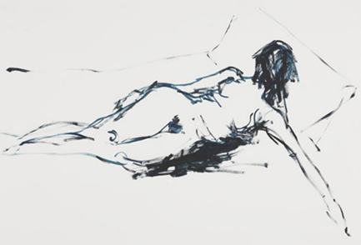
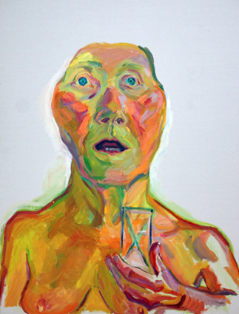
Task 2:
Using one of the figure studies we have explored, produce a piece of work that reflects the same techniques as your distortion artist.
Show similar use of paint, material and texture.
How have you used the intentions of the artist to produce a piece that shows the idea of distortion.
Can you link the piece to the work of Anne Austin Pearce - a sense of inbetween? (This could be visible in Emin and Lassnig’s work below).
Maria Lassnig -
Head appears larger than the body – why?
Secondary and primary colours are used to reflect emotions.
Figure appears wide eyed and gasping for air.
Body is squashed into the frame, the head dominating the composition.
What are the artist’s intentions?
Tracey Emin –
What are the artist’s intentions?
Space overcrowds the form.
Line represents motion and contour
Figure appears unkempt and limbs elongated.
Further research:
Read around your artist using references at the back of your assessment booklet to find out more about their ideas and intentions.

Slide 3

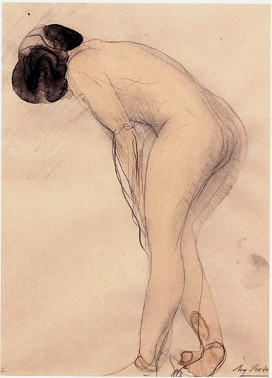
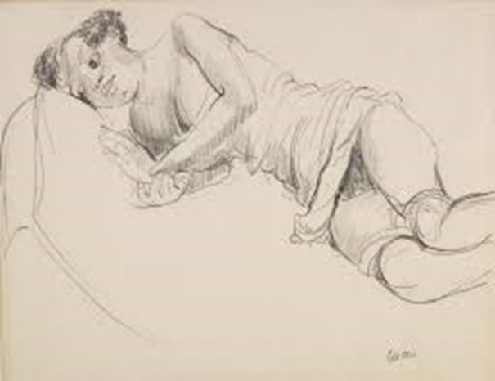
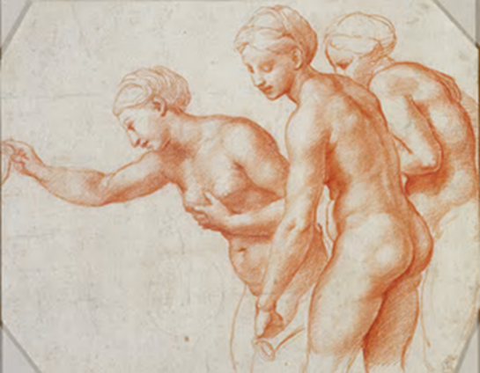

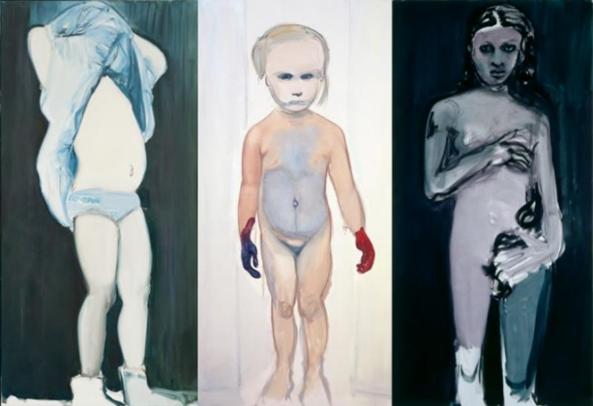
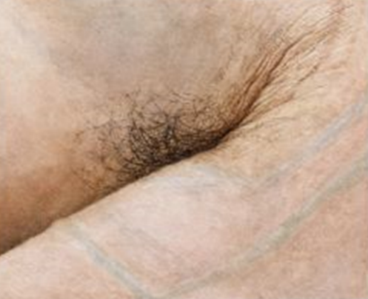
Tracy Emin
Jacob Epstein
Auguste Rodin
Raphael
Marlene Dumas
Maria Lassnig
Ellen Altfest

