Slide 1

Business – Lesson 3
Market Research

Slide 2

What is market research?
Why would a business undertake market research?

Slide 3
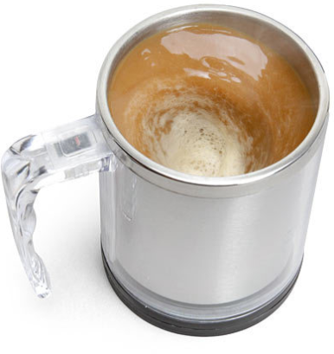
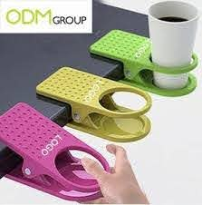
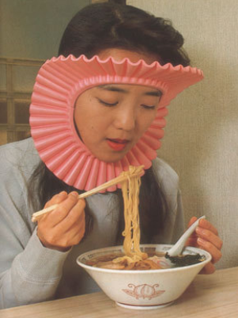


New products…
Notes:
Is there a market for any of these products?

Slide 4
What is market research?
It is a way of finding out if your business idea is worth undertaking
If you’re entering a new market
  Will there be demand for your product / service?
If you’re entering an existing market
  Is there room for another competitor? Will you be able to compete against others?

Slide 5
What is market research?
Watch the video and record in your booklets some of the key areas that you should do market research on
E.g.
Customers – who are you targeting, frequency of purchase, pricing
Product – need? Key features?
Competition – who, how many, size?

Slide 6
Key Terms
Primary Research
Secondary Research
Interviews
Focus Groups
Questionnaires
Internet research
Using newspapers/books
Notes:
Briefly see if students know the difference between primary and secondary research? Can they think of examples?
Then display. Have they ever taken part in a questionnaire or interview for anything?

Slide 7

Key words for questions

Slide 8
Open and closed questions
Closed questions have a fixed, simple, answer. For example:
  Do you buy sweets?
  How many people live in your house?
Open questions allow for a range of answers?
  What do you like about this product?
  What are you planning to buy today at the supermarket?
  WHAT ARE THE ADVANTAGES AND DISADVANTAGES OF EACH TYPE OF QUESTION?
Notes:
Closed questions only provide basic information BUT allow for easier analysis of results
Open questions provide much greater scope of answers BUT are very difficult and timely to analyse

Slide 9
Questionnaires
Think of a business (alternatively use an ice-cream shop)
Design a Questionnaire
  Minimum of 8 questions
  Have a mixture of open and closed questions
  Think about the information you want
  Don’t forget to ask about Age, Location and Occupation (think about why is this important?)
Notes:
Age etc allow a business to analyse target markets, preferences of different groups and they can tailor their product/service to suit the needs of different people.
Students can use the blank sheet in the booklet to create the questionnaire. There is another blank page to record results but they may record the closed question results on the questionnaire.
Graph paper would be useful for the analysis, i.e. charts

Slide 10

Focus Group
What is a Focus Group?
“A group of people assembled to participate in a discussion about a product before it is launched, or to provide feedback on an existing product”
Notes:
Extension – if you have time remaining after the questionnaire tasks, you can get the students in small groups to conduct focus groups. 5 would be the optimal number – get them to base their discussion on a mobile phone/an app they have on their phone/a shop they are all familiar with.
The idea is they talk about the relative strengths and weaknesses of the product/service and record what the group think.

Slide 11
Plenary
Think of 2 different businesses
Swap with the person next to you
For each business, write how they would conduct market research
  Think about the business
  E.g. How would ASDA conduct different market research to a local shop

