Slide 1
Practical Lesson 2
Learning Objectives:
To complete your written song melody, including staff notation.
To make preparations for your own song composition next lesson.
Key Words:
Melody
Passing note
Auxiliary note
Block chords
Broken chords
Divided chords

Slide 2
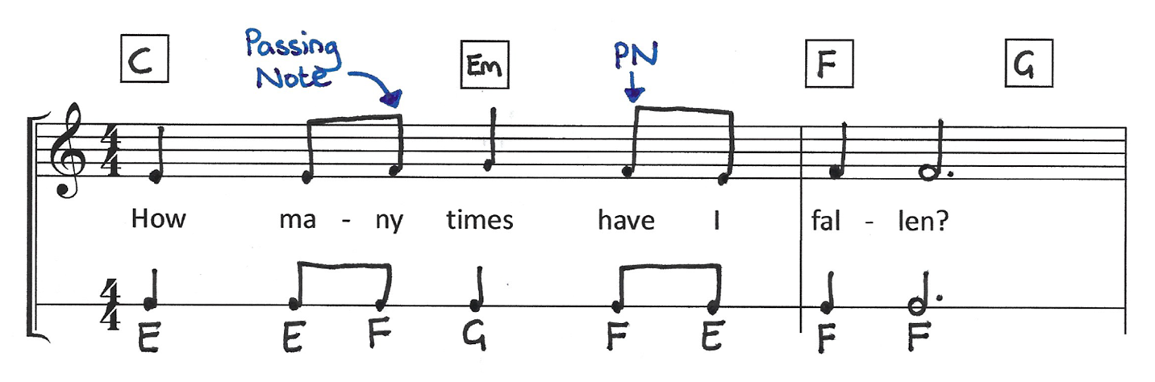
Recapping how to write your melody
Chord Notes: Notes in the chord
Passing Notes: Notes moving by step between the chord notes
Auxiliary Notes: A note above or below a chord note that returns to the same note

Slide 3
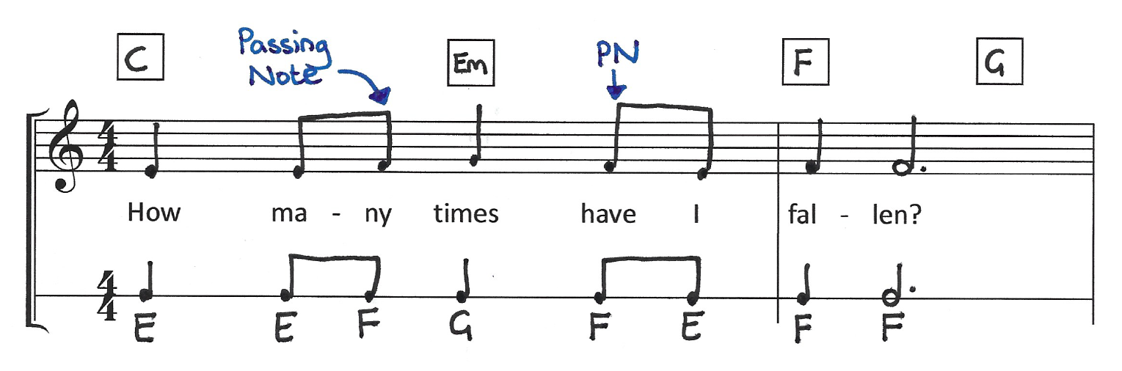
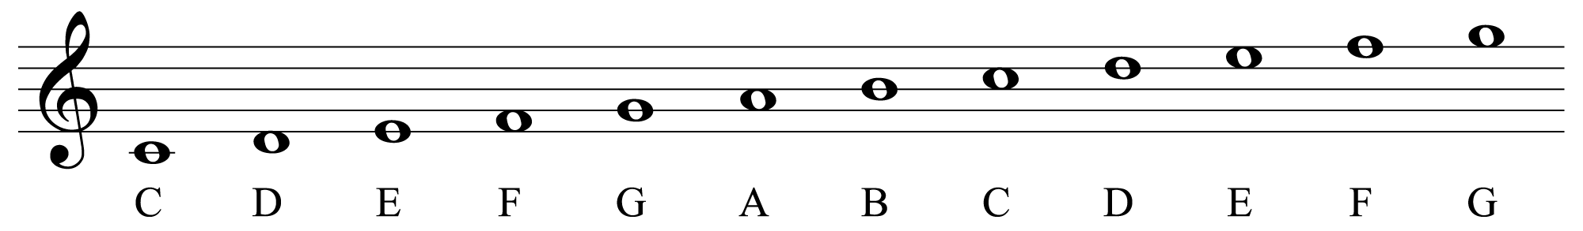
Recapping Notating Your Melody
Use the stave on page 19 of your booklet to help notate your melody:

Slide 4
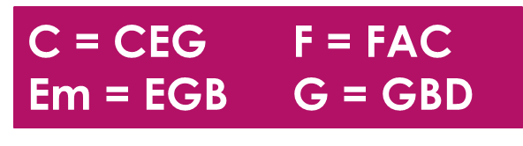
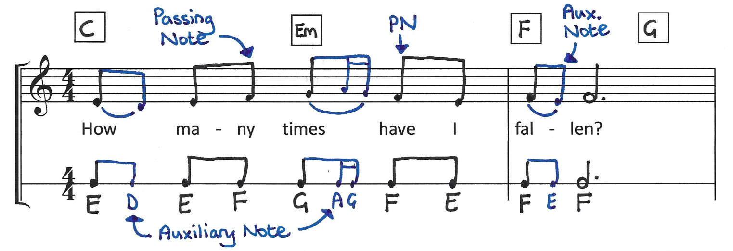
Enhancing your melody with melismas
Syllabic word setting: one note per word/syllable
Melismatic word setting: more than one note per word/syllable

Slide 5

Your Task
Develop your melody for the song ‘How Many Times’:
Use chord notes, with some passing notes and/or auxiliary notes to smooth out the melody line.
Consider using some melismas to vary your melody.
Play your melody as you write it to check how it sounds!
Add the chords – try using different chord patterns.
Notate your melody on the stave (you will get help with this).
Add an introduction and or outro to your song.

Slide 6
Next Lesson!
Next lesson you will be applying the techniques you have learned so far to write your own song.
A selection of words will be provided but if you wish to use your own you must bring them to the next lesson on a piece of paper.
Any words must be appropriate for use in school. If you are unsure, the answer is probably no!
Thinking ahead…

